Slide 1
Review Chapter 4
1990’s Celebrity Edition

Slide 2
Remember to Read all your Sources!!

Slide 3
Definitions Part one:
Affirm:
Annuity:
Patriate:

Slide 4
Answers
Affirm: to validate and express commitment to something
Annuity: a fixed sum of money paid to someone or a group of people each year, typically for the rest of their life
Patriate: transfer control over (a constitution) from a mother country to its former dependency.

Slide 5
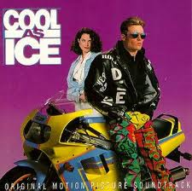
Nice Work! Keep it up!

Slide 6
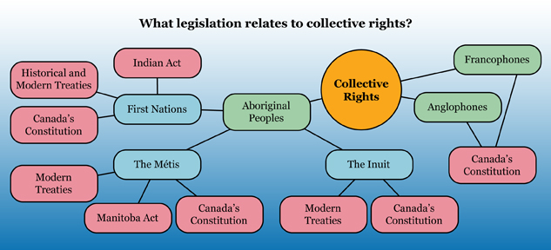
Copy this web it can only help you!

Slide 7
Perspectives on numbered treaties
To preserve our culture it is necessary to preserve our status, rights, lands and traditions. Our treaties are the basis of our rights . . . The treaties are historic, moral and legal obligations . . The government must declare that it accepts the treaties as binding . . .
Canadian Government First Nation

Slide 8
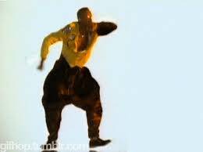
Your turn!! HAMMErtime!!

Slide 9
Definitions part Duex!
Inherent Rights:
Sovereignty:
Ethnocentrism:

Slide 10
Hot shot answers!
Inherent rights: rights with origins in fundamental justice
Sovereignty: supreme power or authority.
Ethnocentrism: the belief that one’s culture is superior to all other cultures

Slide 11
Number treaties
What are the numbered treaties?
Where do they have there root?
What section are these rights affirmed?
What are the three major numbered treaties in Alberta?

Slide 12
Sweet work!

Slide 13
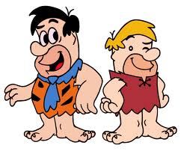
Work with a partner for this part!
Provide three reasons why the numbered treaties were negotiated between first nations in the west and Canada? Pg 126
Describe 4 facts about the Indian Act. Pg 137

Slide 14
We still doing good? Hopefully better than this guys career…

Slide 15
Definitions part 3
Official Language Community:
Official Language Minority:
Assimilate:

Slide 16
Part 3 answers
Official Language Community: one the groups in Canadian society whose members speak an official language of Canada – French or English – as their first language
Official Language Minority: a group that speak son of Canada’s official languages and that does not make up the majority population of province or territory
Assimilate: become part of a different cultural group.

Slide 17
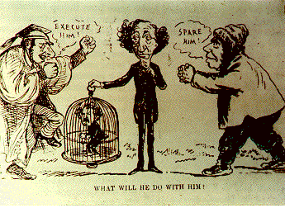

Slide 18
Metis rights
Section 35:
Metis Population betterment Act:
Northwest Rebellion:
Louis Reil:

Slide 19
Time to go it alone!

